Slide 1
Kubernetes Hands On
Part 1

Slide 2
Github Repository
Please clone the repository for all the files, commands and instructions
https://github.com/keshavprasadms/kubernetes-training

Slide 3
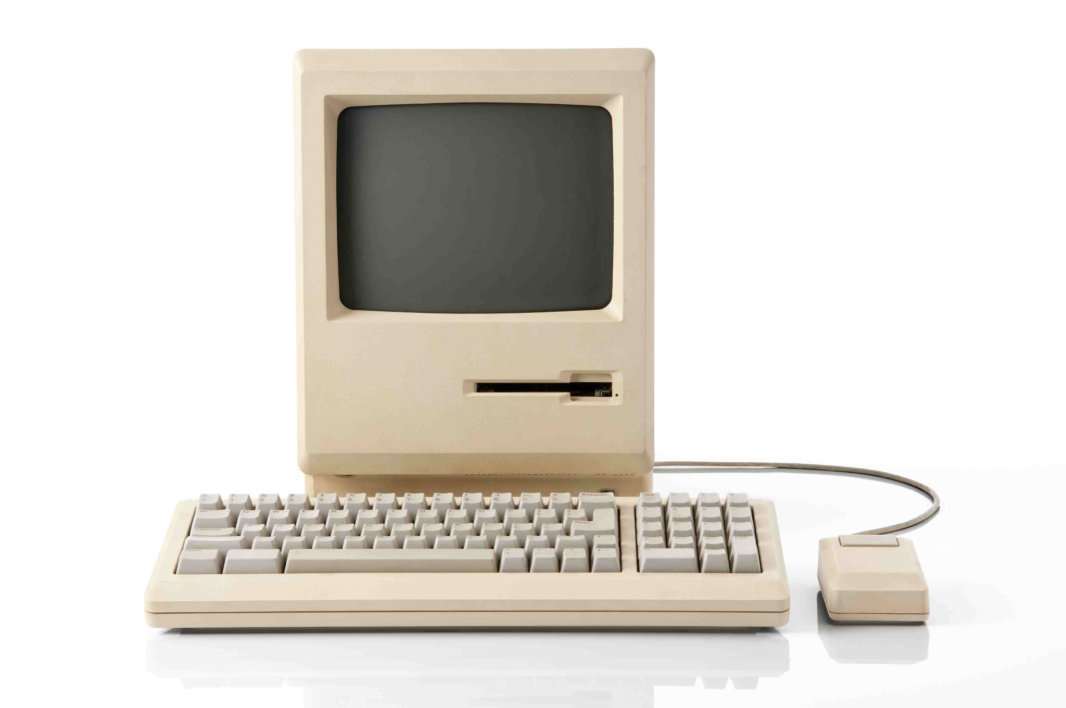
Physical Machine
A physical server, also known as a ‘bare-metal server,’ is a single-tenant computer server, meaning that a specific physical server is designated to a single user
The resources and components of a physical server are not shared between multiple users. Each physical server includes memory, processor, network connection, hard drive, and an operating system (OS) for running programs and applications
Notes:
Users on a system - Isolation
Multiple vagrants
Demo on installing and running a software

Slide 4
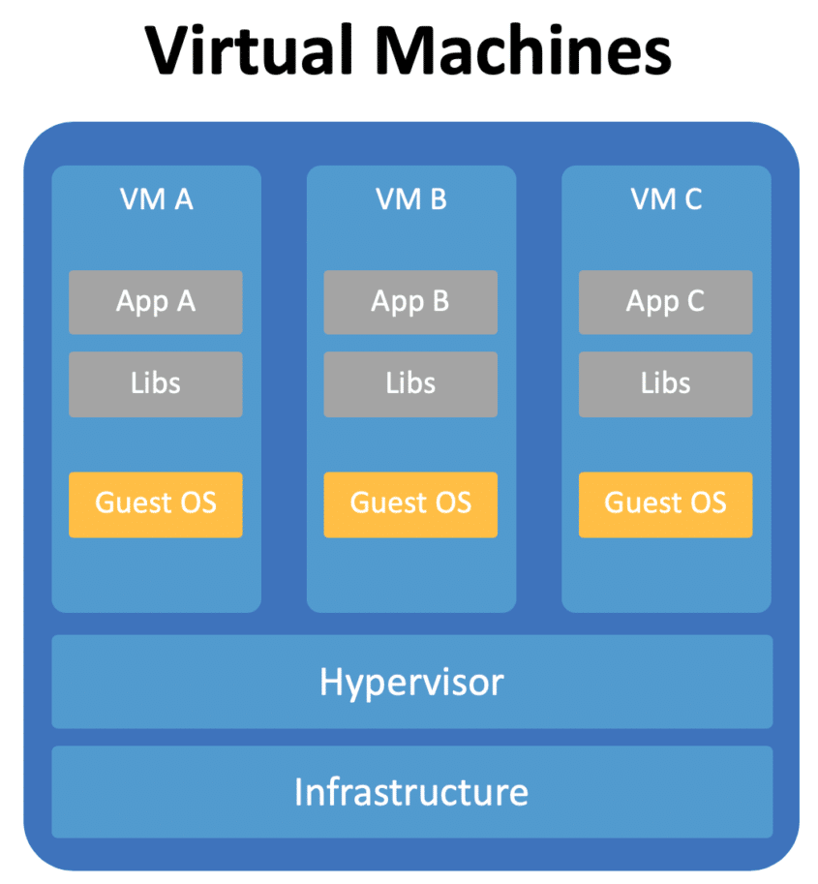
Virtual Machine
Virtualisation is the process of creating a software-based or "virtual" version of a computer, with dedicated amounts of CPU, memory and storage that are "borrowed" from a physical host computer—such as your personal computer— and/or a remote server—such as a server in a cloud provider's data centre
A virtual machine is a computer file, typically called an image, which behaves like an actual computer. It can run in a window as a separate computing environment, often to run a different operating system—or even to function as the user's entire computer experience
The virtual machine is partitioned from the rest of the system, meaning that the software inside a VM cannot interfere with the host computer's primary operating system
Notes:
Demo on VirtualBox and Vagrant and the OS images

Slide 5
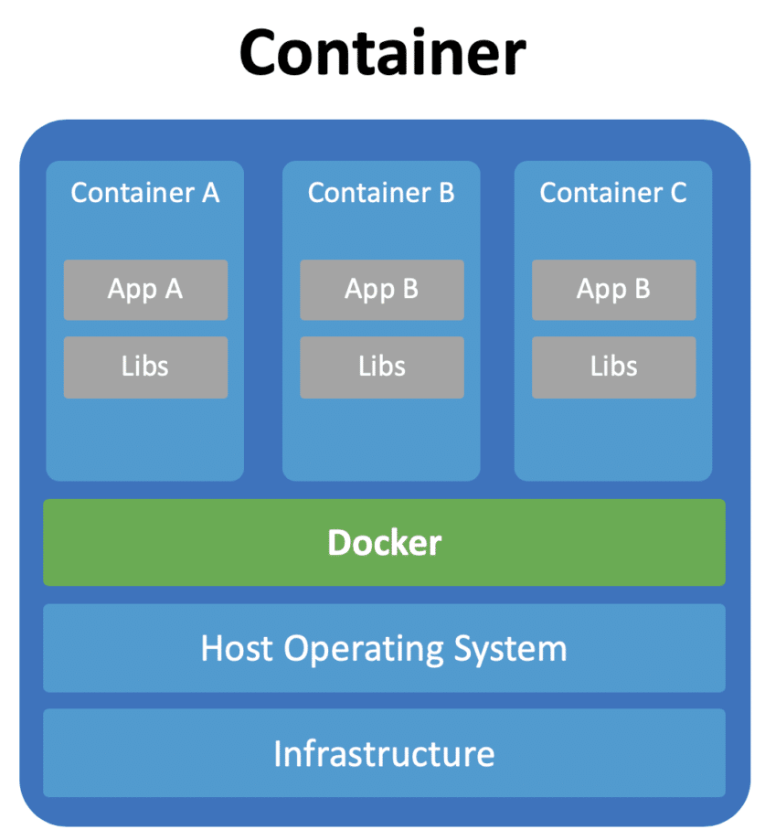
Docker
Docker is an open platform for developing, shipping, and running applications. Docker enables you to separate your applications from your infrastructure
Docker provides the ability to package and run an application in a loosely isolated environment called a container. The isolation and security allows you to run many containers simultaneously on a given host
Containers are lightweight and contain everything needed to run the application, so you do not need to rely on what is currently installed on the host. You can easily share containers and be sure that everyone you share with gets the same container that works in the same way
Notes:
Demo on docker and images

Slide 6
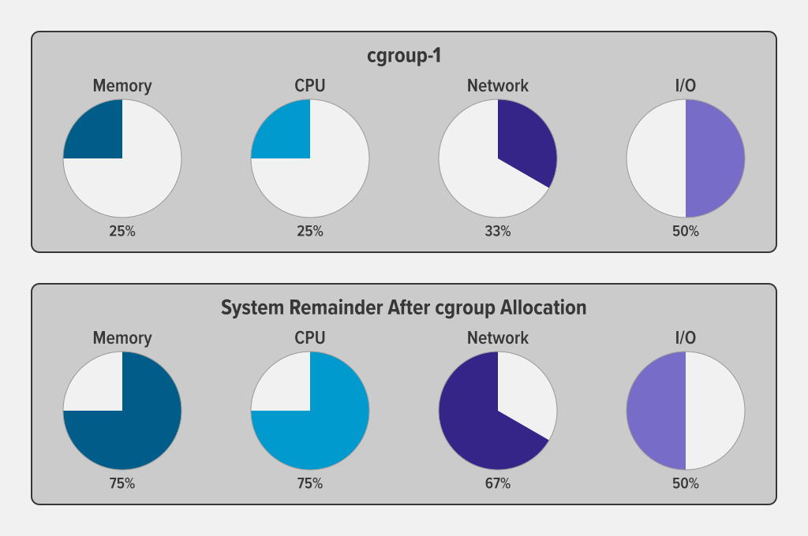
Linux Cgroups

Slide 7
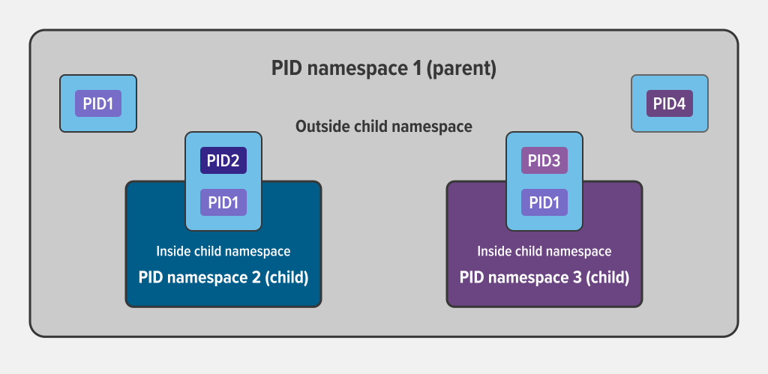
Linux Namespaces

Slide 8
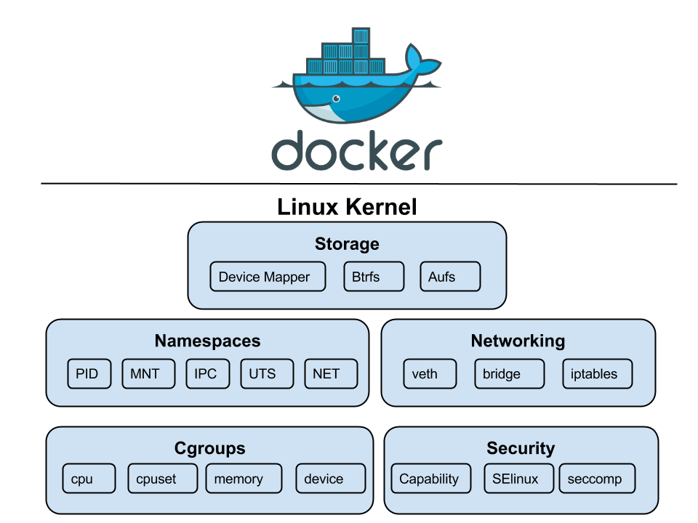
Docker Isolation

Slide 9
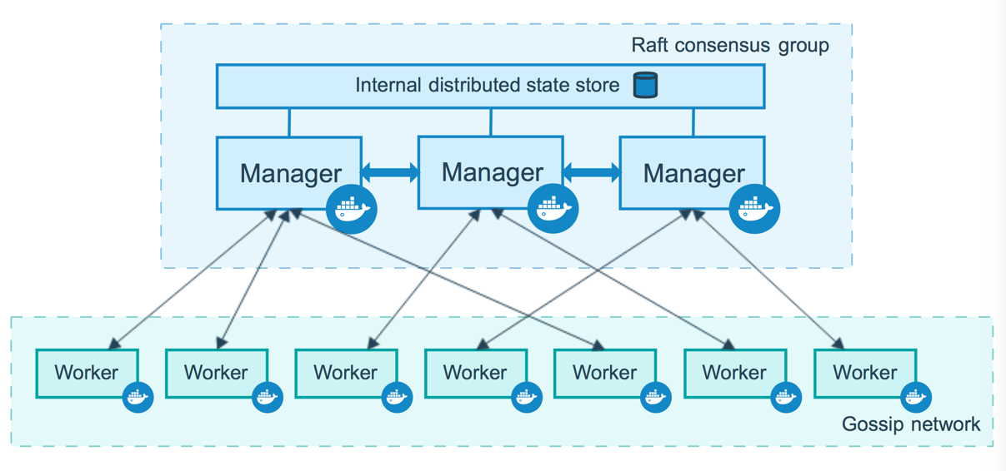
Docker Swarm

Slide 10
Hands On
Part 1 Hands on exercise
https://github.com/keshavprasadms/kubernetes-training/blob/main/Part1/part1-commands.md
Notes:
Need a docker hub account

